Slide 1
An inductive approach to strand spaces

Slide 2
security protocol analysis
formal approaches
BAN logic
model checking
Paulson’s inductive method
the strand space method

Slide 3
Contents
strand space theory
the difficulties, motivations, contributions
formalized strand space theory (in a theorem prover)
formalize and prove protocol properties
Needham–Schroeder–Lowe (NSL) protocol
Otway–Rees protocol

Slide 4

Preliminaries
Messages

Slide 5
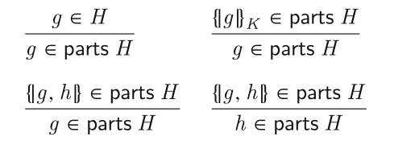
Preliminaries
operators parts
{g}k in parts H => g in parts H ???
H contains a penetrator’s initial knowledge and all messages sent by regular agents

Slide 6
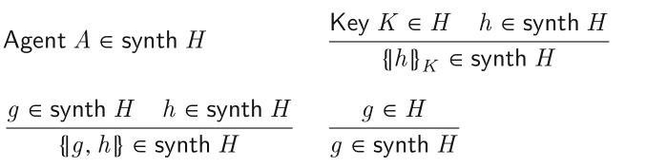
Preliminaries
operators synth
characterizes a penetrator’s ability to deduce knowledge from a message set H

Slide 7
Preliminaries
Strands and strand space
Actions：send and receive/Sign ={+, −}
Events：(σ,t)
A protocol defines a sequence of events for each agent’s role.
A strand represents a sequence of an agent’s actions in a particular protocol run, and is an instance of a role
A strand space is a mapping from a strand set to a trace
node, Domain, =>, ->,
Bundles: represents a protocol execution
Causal precedence

Slide 8

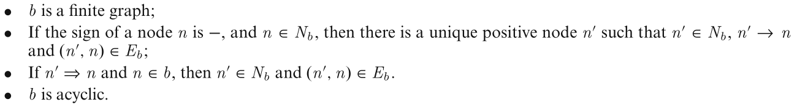
Preliminaries
Bundles
casually well-founded graph

Slide 9
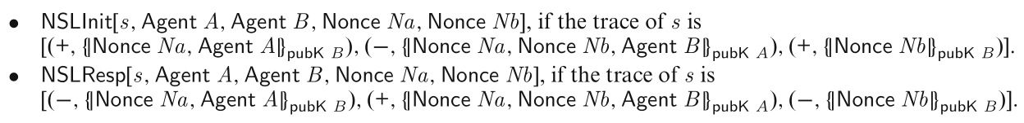
Preliminaries
Protocol modeling using strands
role: initiators, responders,servers
parameter: names, nonces
parameterized strand: role[parameter list]
example： NSL

Slide 10
Preliminaries
Penetrator
bad and regular
the set bad：the set of all penetrators
penetrator strands
KP：a set of keys known to all penetrators initially

Slide 11
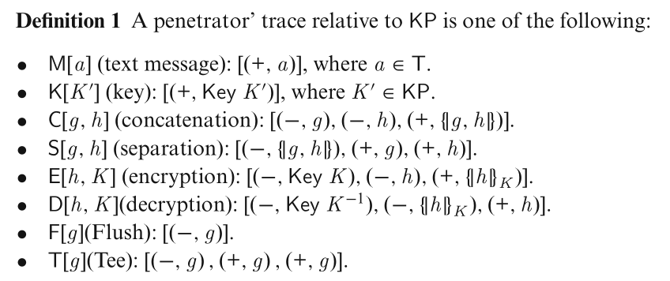
Preliminaries

Slide 12
Preliminaries
Specifying security properties
authentication
there is a responder strand Resp[x] and the i-th node of the strand is in a bundle b, then there is an initiator strand Init[x] and some j-th node of the initiator strand is in b.
secrecy
A message g is secret for a protocol if in every bundle b of the protocol the penetrator cannot receive g in cleartext
For a key K, if Key K can be kept secret, then K is safe

Slide 13
Preliminaries
Authentication tests (guarantee the existence of the transforming edges in a bundle, which is done by a regular agent)
Outgoing tests
Incoming tests
Unsolicited tests

Slide 14
Motivations and Contributions
motivations
a better definition of bundles to formalize the operational semantic protocol steps
many definitions and proofs of the strand space method are informal and complicated(rule induction)
proofs of authentication tests are extremely complicated

Slide 15
Motivations and Contributions
contributions
improve the strand space theory
inductive definition for bundles
redefine the subterm relation and introduce test suite formally
A generalized version of authentication tests
formalize the newly extended strand space theory in a theorem prover
A formal theory strand.thy in Isabelle/HOL
applicable generally for real-world protocol analysis

Slide 16
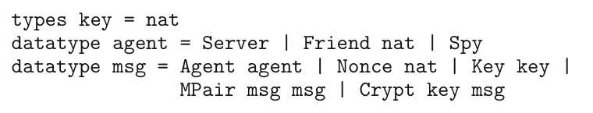
A formalized strand space theory in Isabelle
Messages

Slide 17
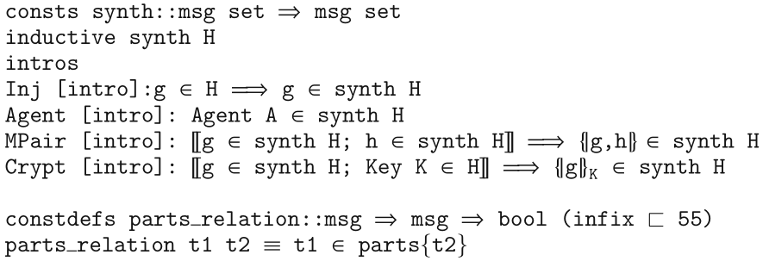
A formalized strand space theory in Isabelle
parts and synth operators

Slide 18
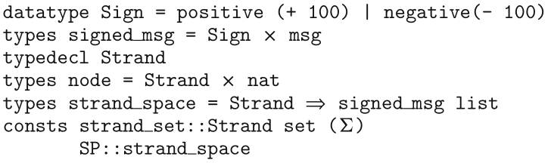
A formalized strand space theory in Isabelle
Strands and strand spaces

Slide 19
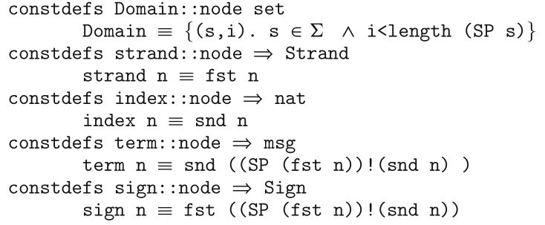
A formalized strand space theory in Isabelle
Domain: the set of all the nodes
strand, index, term, sign: the operators on a node

Slide 20
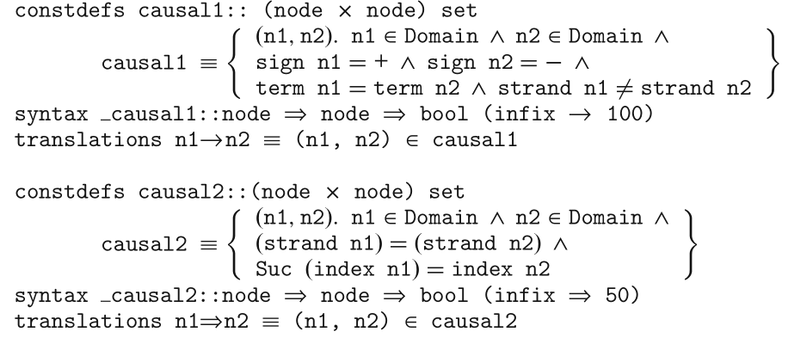
A formalized strand space theory in Isabelle
the causal relations

Slide 21
A formalized strand space theory in Isabelle
Bundles——inductive definition
Rule Nil (specifies an empty bundle)
Rule Add_Pos1
Rule Add_Pos2
Rule Add_Neg1
Rule Add_Neg2
P holds for every bundles -- inductive principle
elimination rule bundles.induct

Slide 22
A formalized strand space theory in Isabelle
Prove that a bundle is a well-founded graph
finite x : denote that x is a finite set.
wf r: denote that r is a well-founded relation.

Slide 23
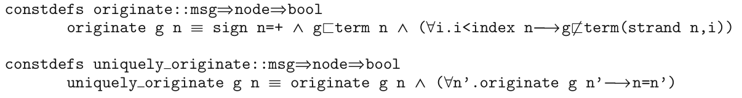
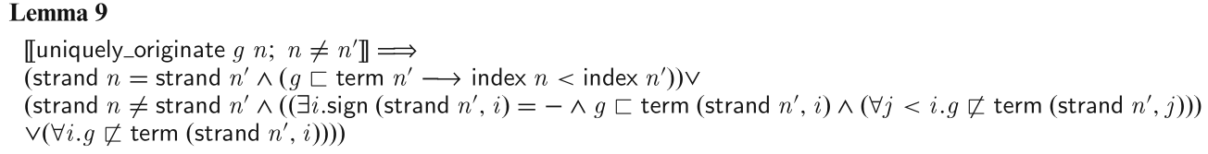
A formalized strand space theory in Isabelle
Freshness assumptions
confidential items such as nonces and session keys uniquely originate from some node
predicate: originate g n (n is the first node where g occurs in the strand)
predicate: uniquely_originate g n (there is only one node which originates g)

Slide 24
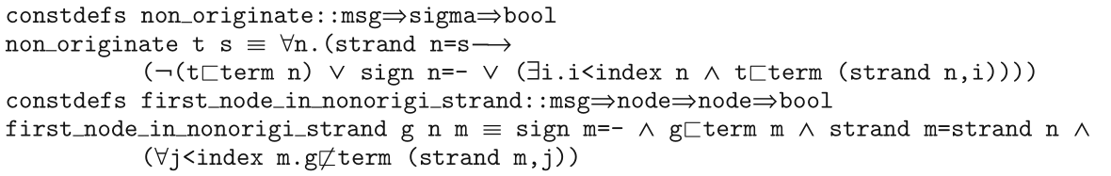
A formalized strand space theory in Isabelle
Freshness assumptions
predicate: non_originate g s ( message g does not originate from any node in strand s)
predicate: first_node_in_nonorigi_strand g n m( g does not originate from the strand in which n and m lie, and m is the first node containing g in this strand)

Slide 25
A formalized strand space theory in Isabelle
Path
a path in a bundle from a node m at which a message g uniquely originates to a node n which contains g as a subterm
shows the existence of the causal precedence from m to n in the bundle
Completely Transforming Path

Slide 26
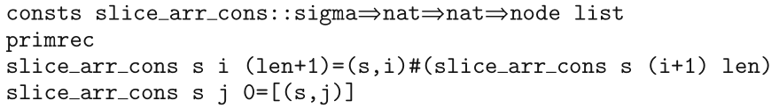
A formalized strand space theory in Isabelle
Completely Transforming Path
a function: slice_arr_cons s j len (returns a consecutive node list [(s, j), ..., (s, j + len)])

Slide 27
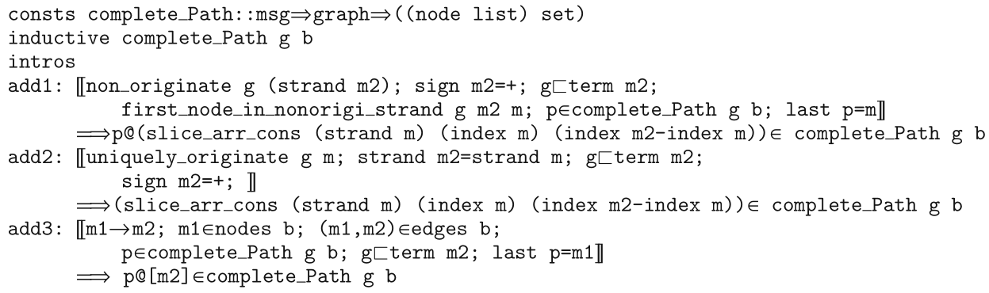
A formalized strand space theory in Isabelle
Completely Transforming Path
function: last p (a CTP p's last element)

Slide 28
A formalized strand space theory in Isabelle
Completely Transforming Path

Slide 29
A formalized strand space theory in Isabelle
Proof of Lemma 13
paper-and-pen proof
Case Add_pos1... If n2!=n'...
mechanical proof

Slide 30
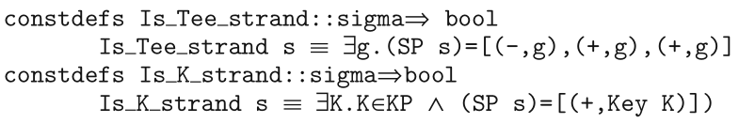
A formalized strand space theory in Isabelle
Penetrators
bad: the set of all the penetrators
KP: the set of all the keys which is initially known to all the penetrators
penetrator strands
T strands (T[g])
K strands (K[K])

Slide 31
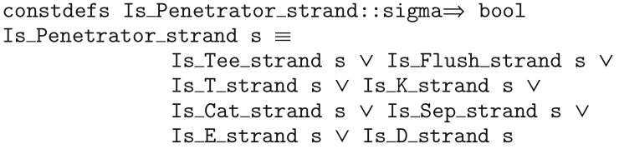
A formalized strand space theory in Isabelle
Penetrators
Is_Penetrator_strand s
Is_Regular_strand s = ! Is_Penetrator_strand s

Slide 32
A formalized strand space theory in Isabelle
Penetrators
regularK K (K cannot be penetrated in a bundle)
component t b ( t is a basic unit that cannot be analyzed in b by penetrators )
a test suite G (message set)

Slide 33
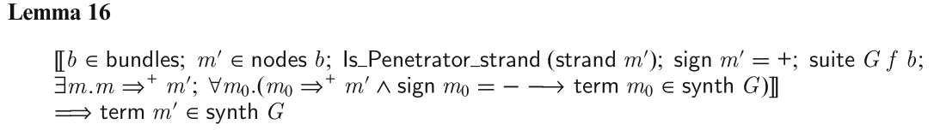
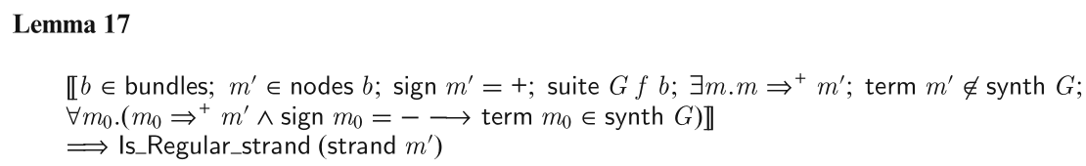
A formalized strand space theory in Isabelle
Penetrators

Slide 34
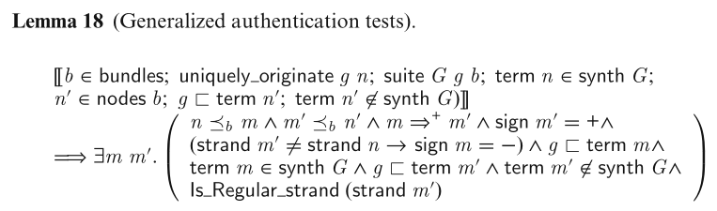
Generalized authentication tests

Slide 35
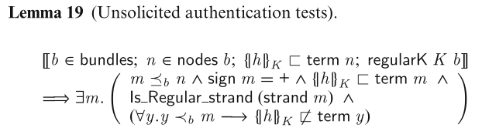
Unsolicited authentication tests
outgoing authentication tests

Slide 36
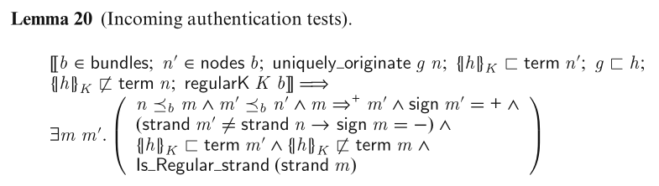
Incoming authentication tests

Slide 37
Application
prove the secrecy of a long term key K, which is not a part of any message
prove the secrecy of an atom a which is a part of a message

Slide 38
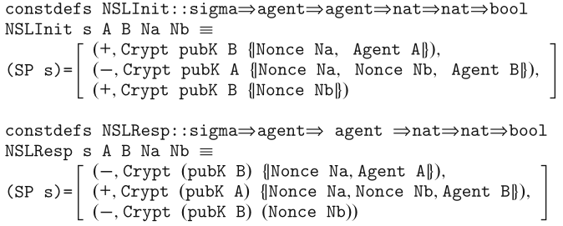

Needham–Schroeder–Lowe protocol
define an initiator and a responder strands of NSL protocol
define the strand space of NSL protocol

Slide 39
Needham–Schroeder–Lowe protocol
prove the secrecy property on any regular key

Slide 40
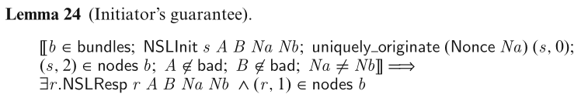
Needham–Schroeder–Lowe protocol
Initiator's and responder’s authentication guarantee

Slide 41
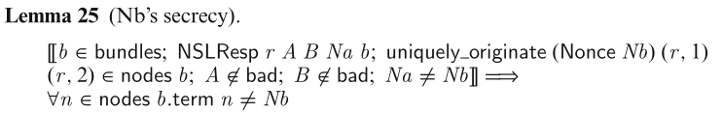
Needham–Schroeder–Lowe protocol
prove the secrecy of the nonce Nb which is originated by a responder

Slide 42
the Otway–Rees protocol

